Slide 1
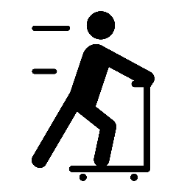
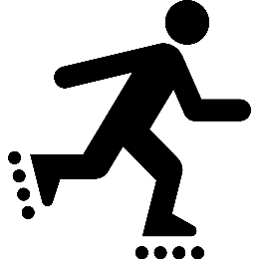
Youth Pedestrian Safety Lessons
DAY 4 – PEDESTRIAN CHALLENGES

Slide 2
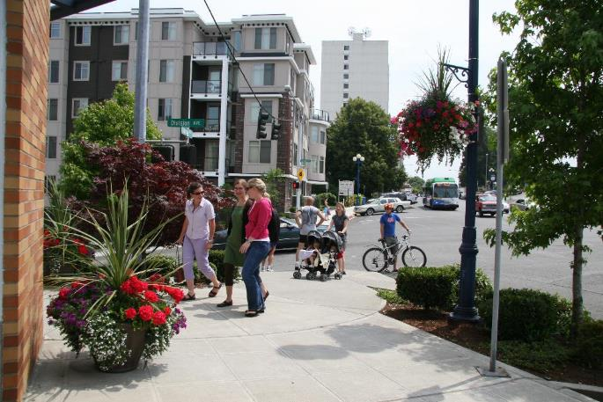
PEDESTRIAN: Someone who walks or moves about using a wheelchair.
ACTION: Walk in place.

Slide 3
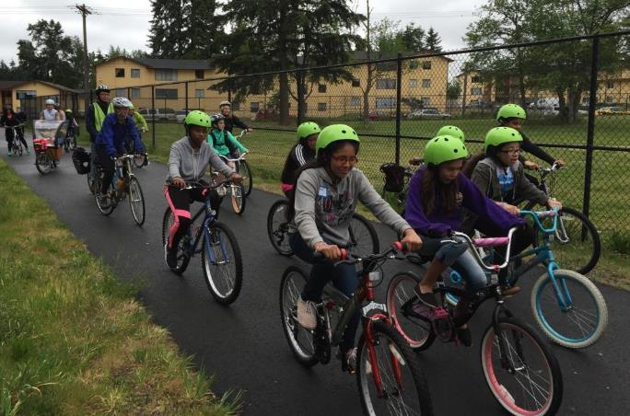
BICYCLIST: Someone who rides a bicycle.
ACTION: Lay on your back and do bicycle crunches OR move your body like you're riding a bike.

Slide 4
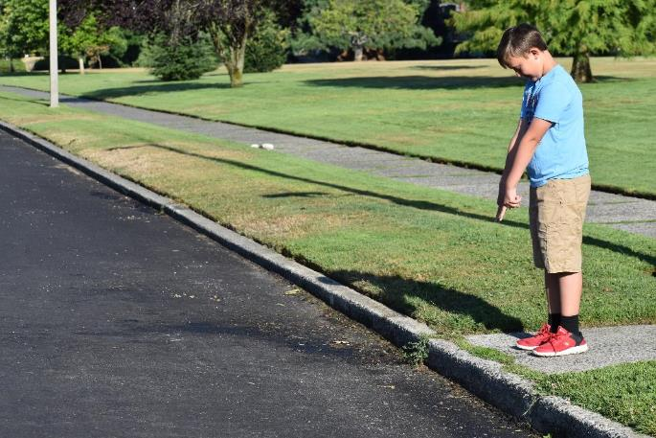
EDGE: A border or outside limit to an area. In this case, where the sidewalk meets the road.
ACTION: Raise your hands above your head, then bring them down and point at an imaginary line in front of you. Repeat.

Slide 5
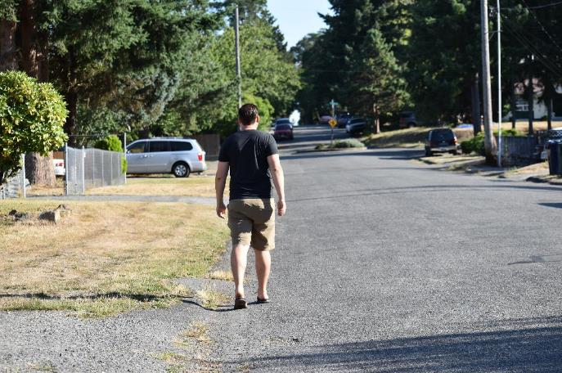
SHOULDER: The edge of the road where cars do not drive. Sometimes a white line separates the shoulder from the road. Cars also sometimes park in the shoulder. The shoulder is used as a sidewalk if there is no sidewalk.
ACTION: Twist your body while brushing each shoulder with the opposite hand.

Slide 6
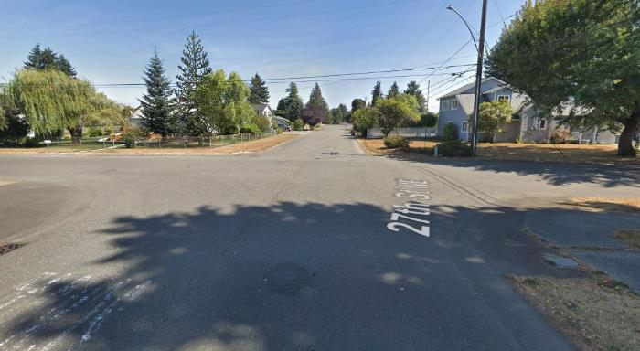
INTERSECTION: A place where two or more streets meet and cross each other.
ACTION: Do five jumping jacks.

Slide 7
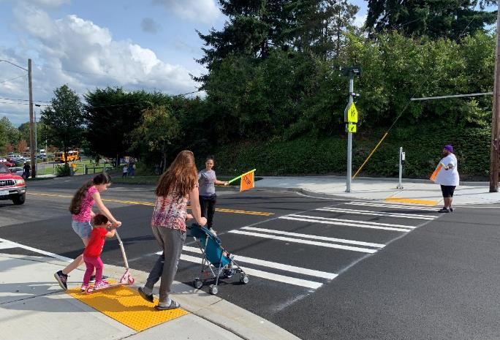
CROSSWALK: Any part of an intersection, either marked with white lines or unmarked, that is for pedestrians to cross the road.
ACTION: Take five steps, then look left-right-left.

Slide 8
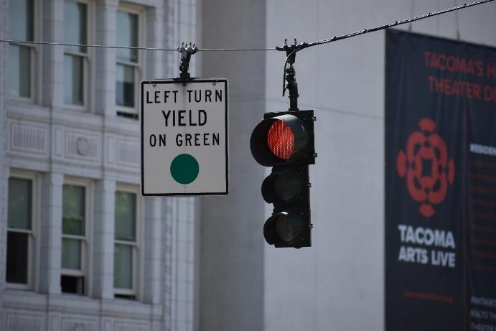
SIGNAL: A gesture, picture, or sound used to give information or instructions.
ACTION: Skip in place.

Slide 9
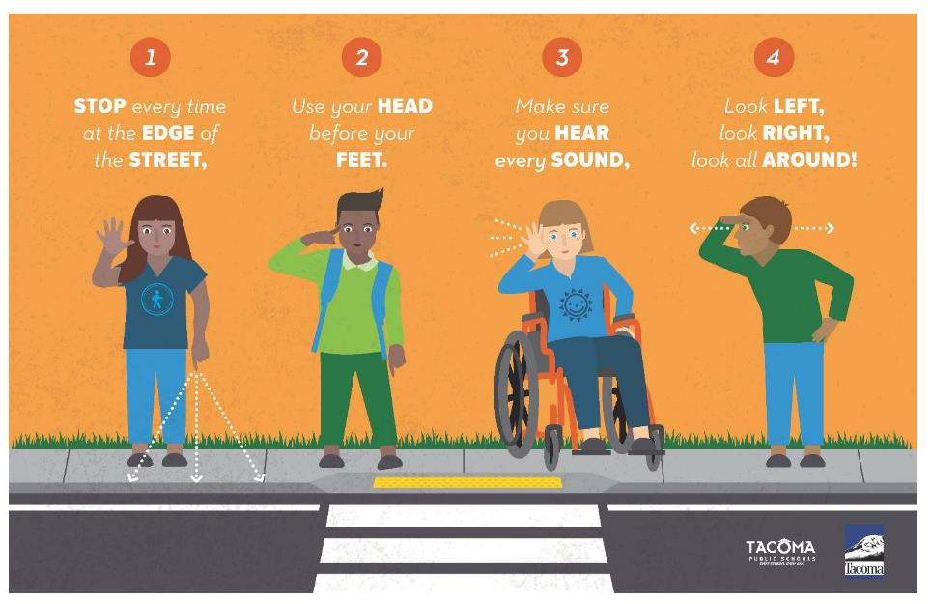

Slide 10
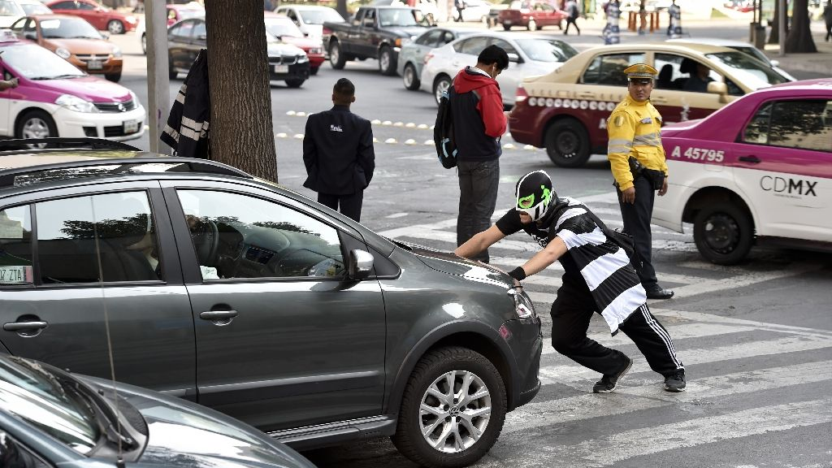
Day 4: Peatónito Video (3:30 minutes)
https://abcnews.go.com/ABC_Univision/video/masked-man-wrestling-traffic-mexico-city-19477342

Slide 11
Day 4, Activity 3: Walk to the Park

Slide 12
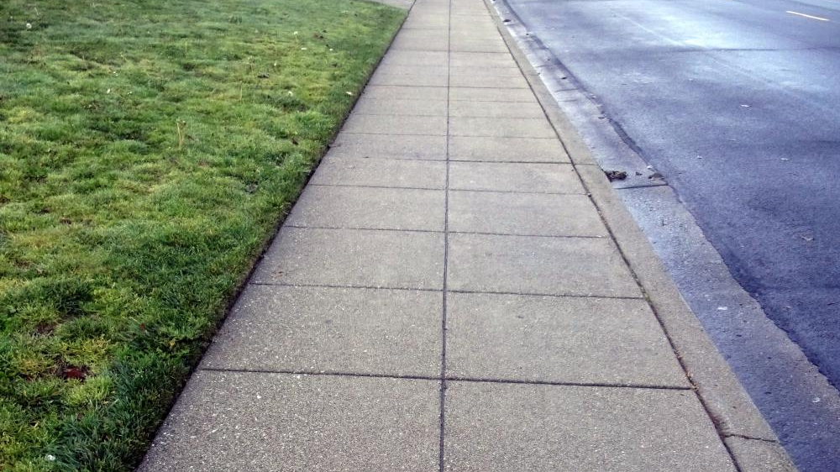
ACTION: run in place

Slide 13
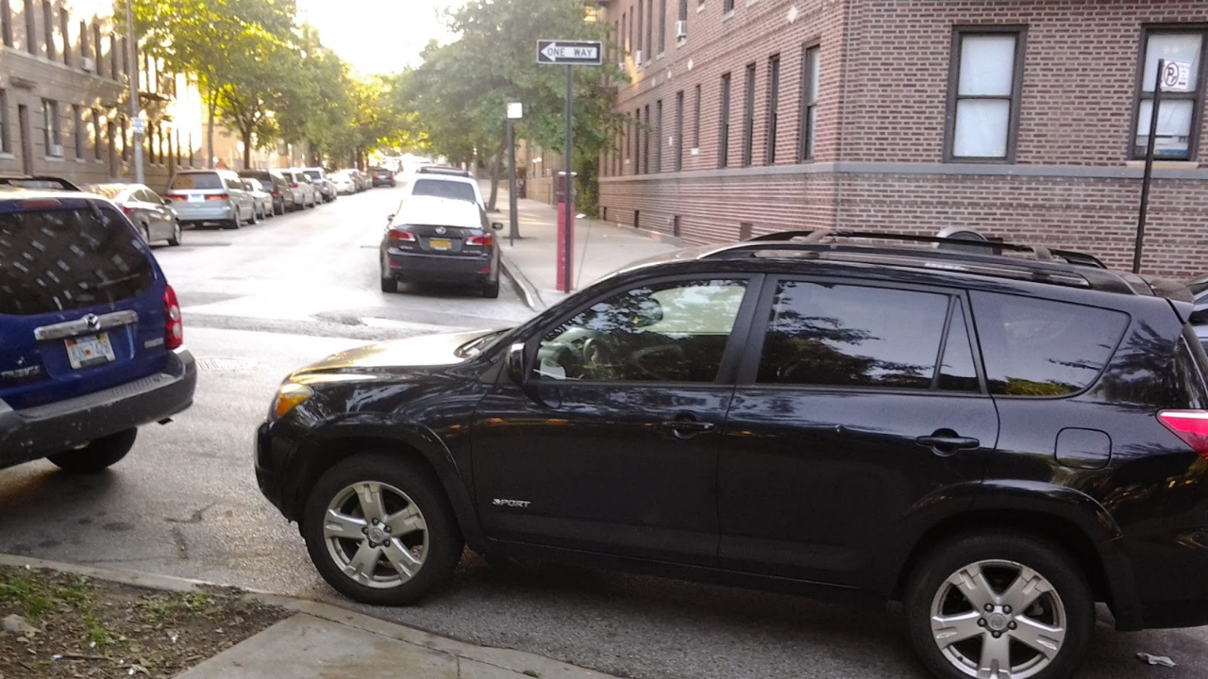
ACTION:
stop
look left-right-left
walk 3 steps
stop
look-left-right-left
continue running

Slide 14
ACTION: run in place

Slide 15
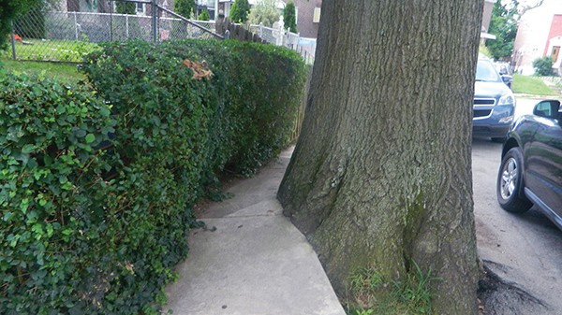
ACTION: walk in place

Slide 16
ACTION: run in place

Slide 17
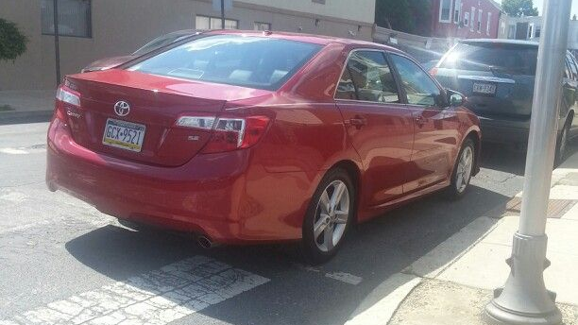
ACTION:
stop
look left-right-left
walk 3 steps
stop
look-left-right-left
continue running

Slide 18
ACTION: run in place

Slide 19
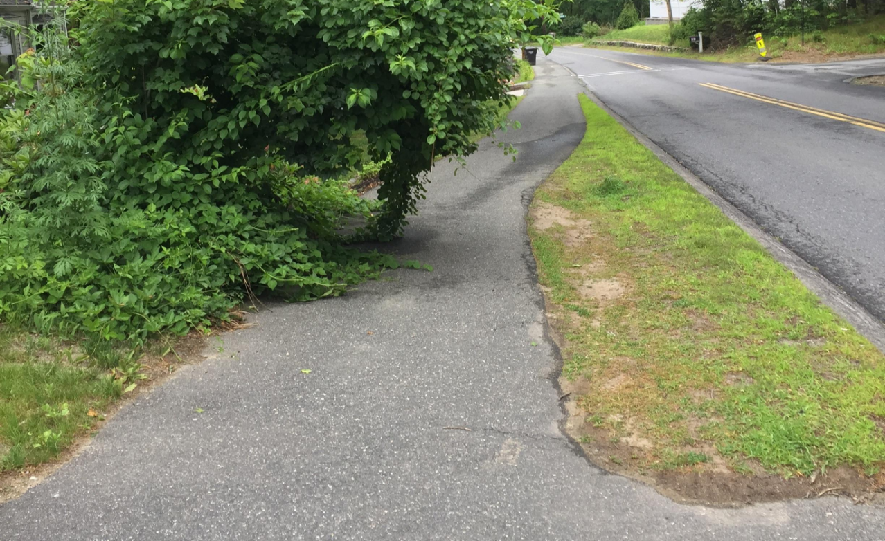
ACTION: walk in place

Slide 20
ACTION: run in place

Slide 21
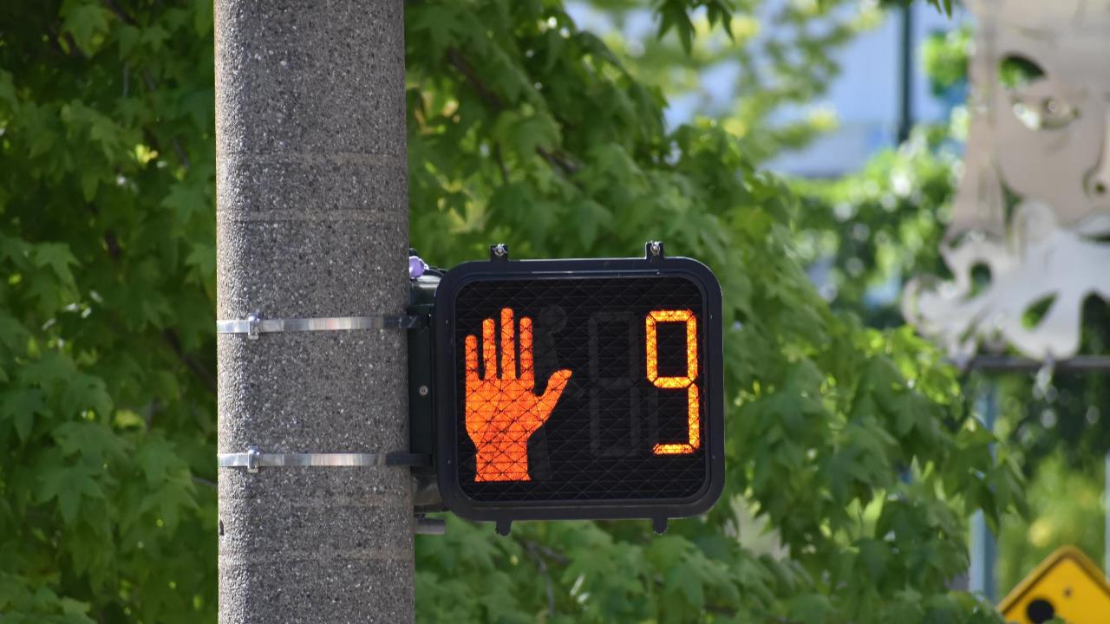
ACTION: walk in place

Slide 22
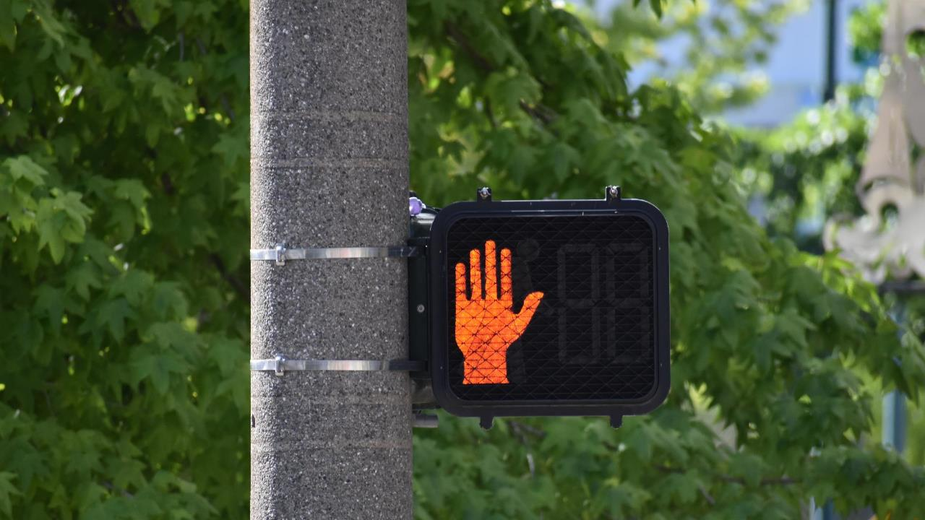
ACTION: jump up and down and alternate putting your hand out like telling someone to stop

Slide 23
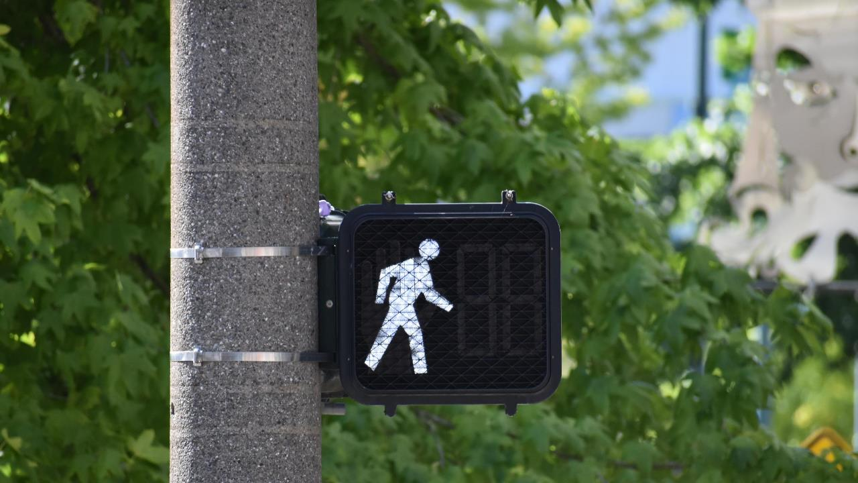
ACTION: look left-right-left, then start to run in place

Slide 24
ACTION: run in place

Slide 25
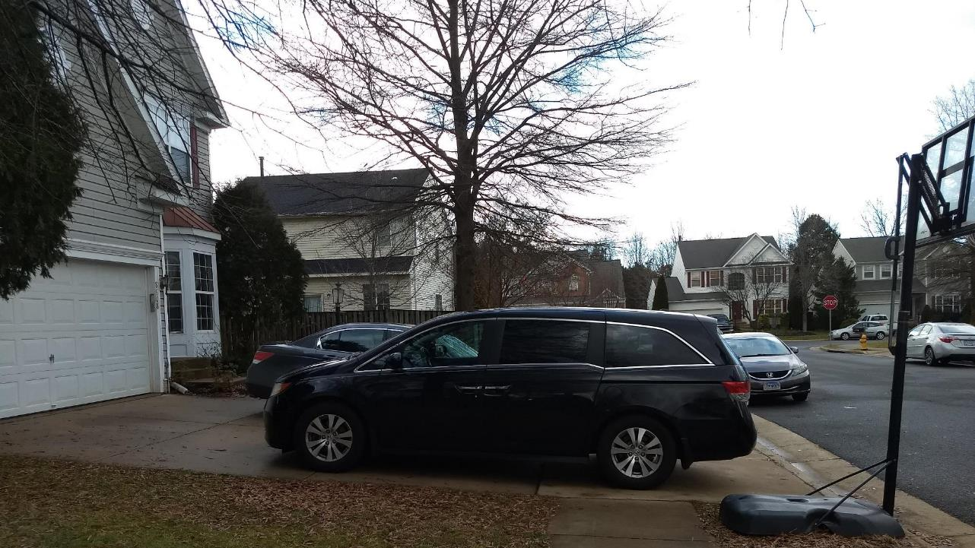
ACTION: walk in place

Slide 26
ACTION: run in place

Slide 27
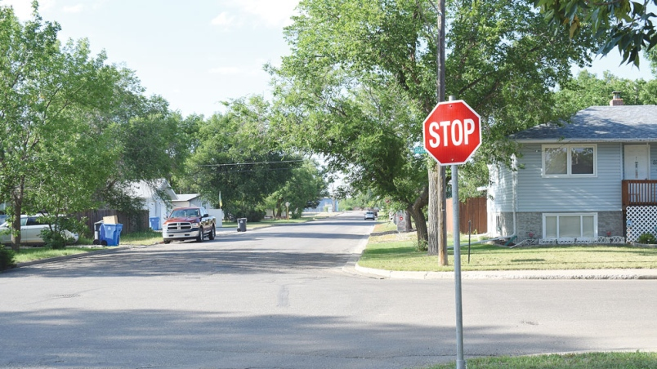
ACTION:
stop
look-left-right-left
continue running

Slide 28
ACTION: run in place

Slide 29
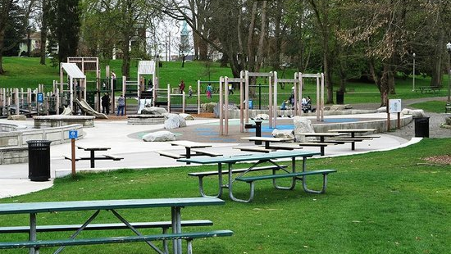
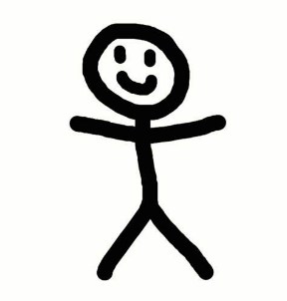
ACTION: do 10 jumping jacks
You-->

